Slide 1
Distributed Systems Unit - V Consistency and Replication
Client-Centric Consistency Models

Slide 2
What is Client-Centric Consistency?
The previously studied data centric consistency models concern themselves with maintaining a consistent (globally accessible) data-store in the presence of concurrent read/write operations.
There is another class of distributed data store which is characterized by the lack of simultaneous updates. Here, the emphasis is more on maintaining a consistent view of things for the individual client process that is currently operating on the data-store.
Client-centric consistency ensures that, from the user’s point of view, data behaves consistently over time even if the system as a whole is only weakly consistent.
Assumption : Client can access different replicas (mobile user)

Slide 3
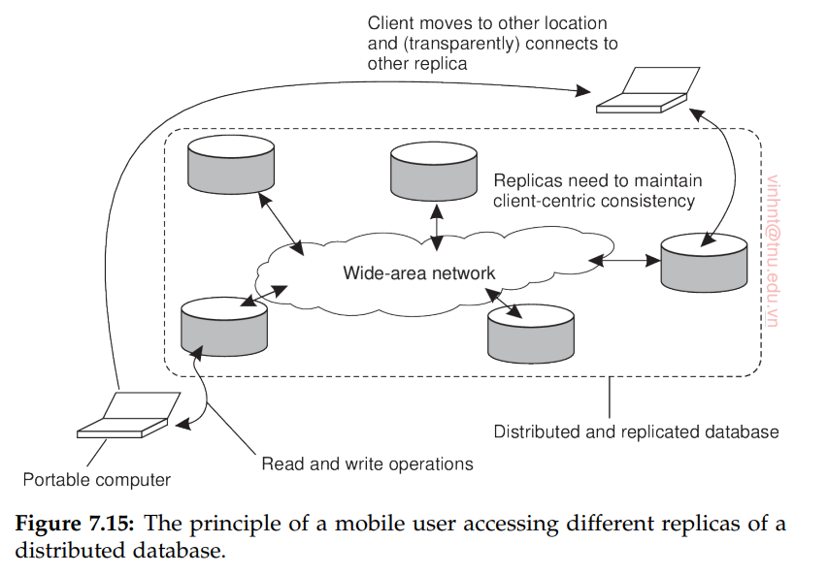
What is Client-Centric Consistency?

Slide 4
What is Client-Centric Consistency?
Suppose you update your profile picture on one server. Later, when you log in from another location, client-centric consistency ensures you still see your updated picture — even if some replicas haven’t yet caught up.
No guarantees are given concerning concurrent accesses by different clients.
If client 2 modifies data that is shared with client 1 but which is stored at a different location, we may easily create write-write conflicts.

Slide 5
Eventual Consistency
In many cases concurrency appears only in restricted form.
In many applications most processes only read data. So, some degrees of inconsistency can be tolerated
In some cases , if for a long time no update takes place then all replicas gradually become consistent.
Eventual Consistency is a weak consistency model in which it is guaranteed that, if no new updates are made to a given data item, all replicas of that item in the distributed data store will eventually converge to the same value.

Slide 6
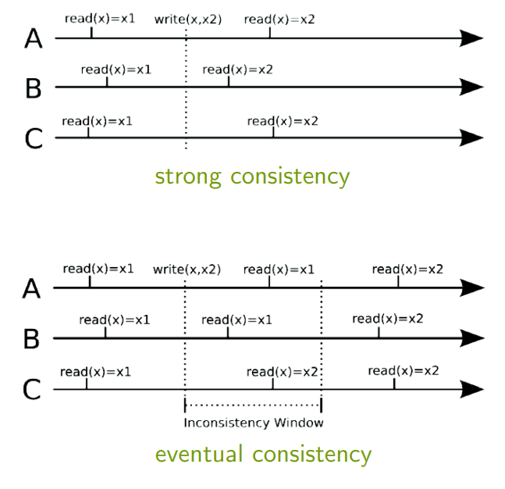

Slide 7
Monotonic Reads
The first client-centric consistency model is that of monotonic reads. A (distributed) data store is said to provide monotonic-read consistency if the following condition holds:
If a process reads the value of a data item x, any successive read operation on x by that process will always return that same value or a more recent value.
In other words, monotonic-read consistency guarantees that once a process has seen a value of x, it will never see an older version of x.

Slide 8
Monotonic Reads
Example : Consider a distributed email system where a user’s mailbox is replicated across multiple servers in different locations.
When the user reads their mail in New Delhi they see certain messages.
Later, if they access their mailbox again in New York, monotonic-read consistency ensures that all the messages seen earlier in New Delhi will still be visible i.e, the user will not miss any previously read emails, even if updates between replicas are delayed.

Slide 9
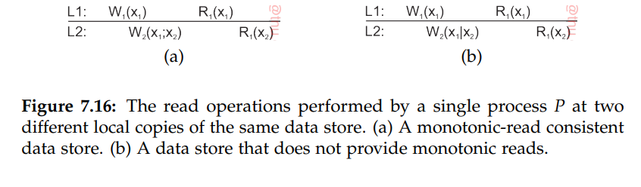
We have two local data stores, L1 and L2, and two processes, P1 and P2, that read and write a shared data item x.
Understanding the Notation:
W1(x1) → Process P1 writes a new version of x, called x1.
R1(x1) → Process P1 reads version x1.
W2(x1; x2) → Process P2 creates version x2, which is based on the previous version x1 (sequential updates).
W2(x1|x2) → Process P2 writes version x2 independently of x1, meaning both updates happened at the same time and might conflict. (concurrent updates)

Slide 10
Monotonic Writes
In a monotonic-write consistent store, the following condition holds:
A write operation by a process on a data item x is completed before any successive write operation on x by the same process.
If we have two successive operations W_{k} (x_{i} ) and W_{k} (x_{j} ) by process P_{k} , then, regardless where W_{k}(x_{j}) takes place, we also have WS(xi ; xj).
Thus, completing a write operation means that the copy on which a successive operation is performed reflects the effect of a previous write operation by the same process, no matter where that operation was initiated.
Monotonic-write consistency resembles data-centric FIFO consistency. The essence of FIFO consistency is that write operations by the same process are performed in the correct order everywhere.

Slide 11
Monotonic Writes
Example: Suppose a software library is updated by replacing some functions.
Monotonic-write consistency ensures that every update is applied in order, meaning all earlier updates are performed before a new one.
This guarantees that the final library version always includes all previous changes and is the most recent, complete version.

Slide 12
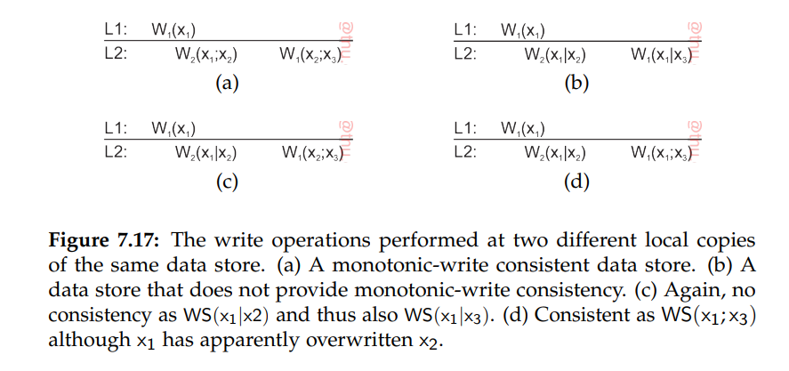

Slide 13
Read your Writes
A data store is said to provide read-your-writes consistency, if the following condition holds:
The effect of a write operation by a process on data item x will always be seen by a successive read operation on x by the same process.
In other words, a write operation is always completed before a successive read operation by the same process, no matter where that read operation takes place.

Slide 14
Read your Writes
For example, to enter a digital library on the Web, it is often necessary to have an account with an accompanying password.
However, changing a password may take some time to come into effect, with the result that the library may be inaccessible to the user for a few minutes.
The delay can be caused because a separate server is used to manage passwords and it may take some time to subsequently propagate (encrypted) passwords to the various servers that constitute the library.

Slide 15
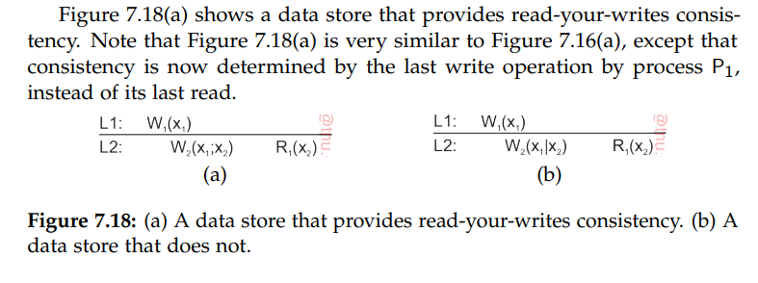
In Figure 7.18(a) process P1 performed a write operation W1(x1) and later a read operation at a different local copy.
Read-your-writes consistency guarantees that the effects of the write operation can be seen by the succeeding read operation. This is expressed by W2(x1; x2), which states that a process P2 produced a new version of x, yet one based on x1.

Slide 16
In contrast, in Figure 7.18(b) process P2 produces a version concurrently to x1, expressed as W2(x1|x2).
This means that the effects of the previous write operation by process P1 have not been propagated to L2 at the time x2 was produced. When P1 reads x2, it will not see the effects of its own write operation at L1

Slide 17
Writes Follow Reads
A data store is said to provide writes-follow-reads consistency, if the following holds.
A write operation by a process on a data item x following a previous read operation on x by the same process is guaranteed to take place on the same or a more recent value of x that was read.
In other words, any successive write operation by a process on a data item x will be performed on a copy of x that is up to date with the value most recently read by that process.

Slide 18
Writes Follow Reads
Example: Assume that a user first reads an article A. Then, she reacts by posting a response B.
By requiring writes-follow-reads consistency, B will be written to any copy of the newsgroup only after A has been written as well.
The writes-follows-reads consistency assures that reactions to articles are stored at a local copy only if the original is stored there as well.

Slide 19
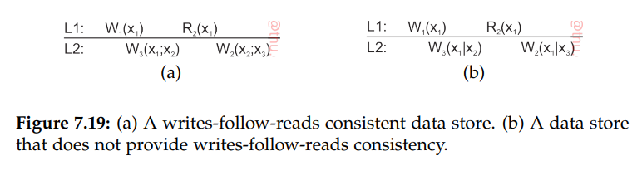
In Figure 7.19(a), process P2 reads version x1 at local copy L1. This version of x was previously produced at L1 by process P1 through the operation W1(x1). That version was subsequently propagated to L2, and used by another process P3 to produce a new version x2, expressed as W3(x1; x2).
When process P2 later updates its version of x after moving to L2, it is known that it will operate on a version that follows from x1, expressed as W2(x2; x3). Because we also have W3(x1; x2), we known that WS(x1; x3).

Slide 20
The situation shown in Figure 7.19(b) is different. Process P3 produces a version x2 concurrently to that of x1.
As a consequence, when P2 updates x after reading x1, it will be updating a version it had not read before. Writes follow-reads consistency is then violated.

Slide 21
Thank You

